Slide 1

EMBEDDED WEB SERVER & PREDICTIVE MAINTENANCE SYSTEM
Anirudh Nishtala – 225807128
Sumedh Prabhudesai – 225807036
Swaminath B – 225807064
Rishiraj Rakesh Kumar - 225807062

Slide 2

Index
Introduction
Scope of the Project
Objectives
Methodology
Project Progress
Expected Results
References

Slide 3

Introduction
Our project focuses on developing an Embedded Web Server integrated with a Predictive Maintenance System.
This solution enables real-time monitoring and remote management of industrial/electronic equipment, predicting failures before they occur, and reducing downtime.
The system enhances operational efficiency by combining embedded technology with data analytics.

Slide 4
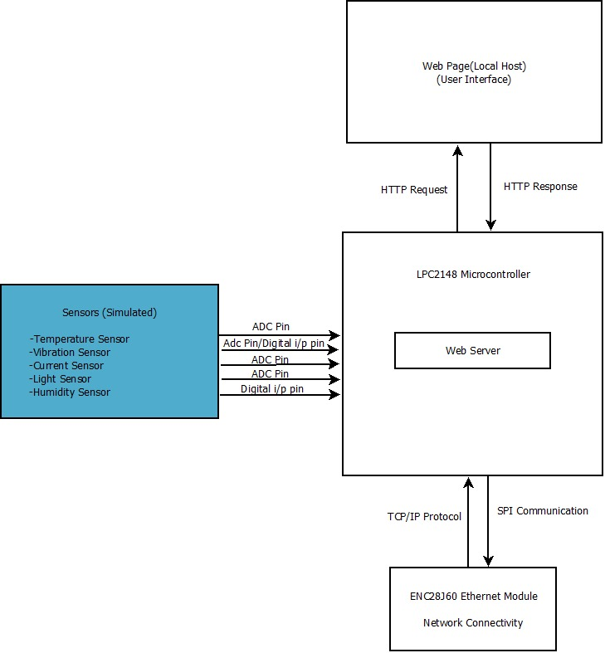
System Architecture:-

Slide 5
Scope of the project
The scope of this project includes making an embedded web server on LPC2148 using an ethernet module ENC28J60 responsible for data transmission and retrieval and built a predictive maintenance system to optimize equipment maintenance and reduce downtime.
Inclusions:-
LPC2148 microcontroller, ENC28J60 ethernet module, Mongoose Web Server Framework, HTML, CSS, Python, mySQL and Flask.
Implement TCP/IP stack.
Real-time data monitoring.
Develop a user-friendly web interface.

Slide 6
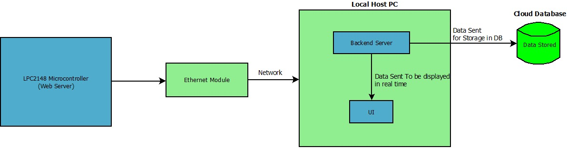
Working Procedure:-

Slide 7
Objectives
The objective of this project is to develop an efficient and reliable Embedded Web Server integrated with a Predictive Maintenance System. The key goals include:-
Real-time Monitoring: Enable continuous monitoring of industrial equipment via a web interface.
Predictive Analytics: Implement data-driven algorithms to predict potential equipment failures.
Remote Access: Provide secure remote access for users to monitor and manage equipment from anywhere.

Slide 8

Methodology
Requirement Analysis
System Design
Hardware and Software integration
Web Interface Development
Implementation and testing

Slide 9
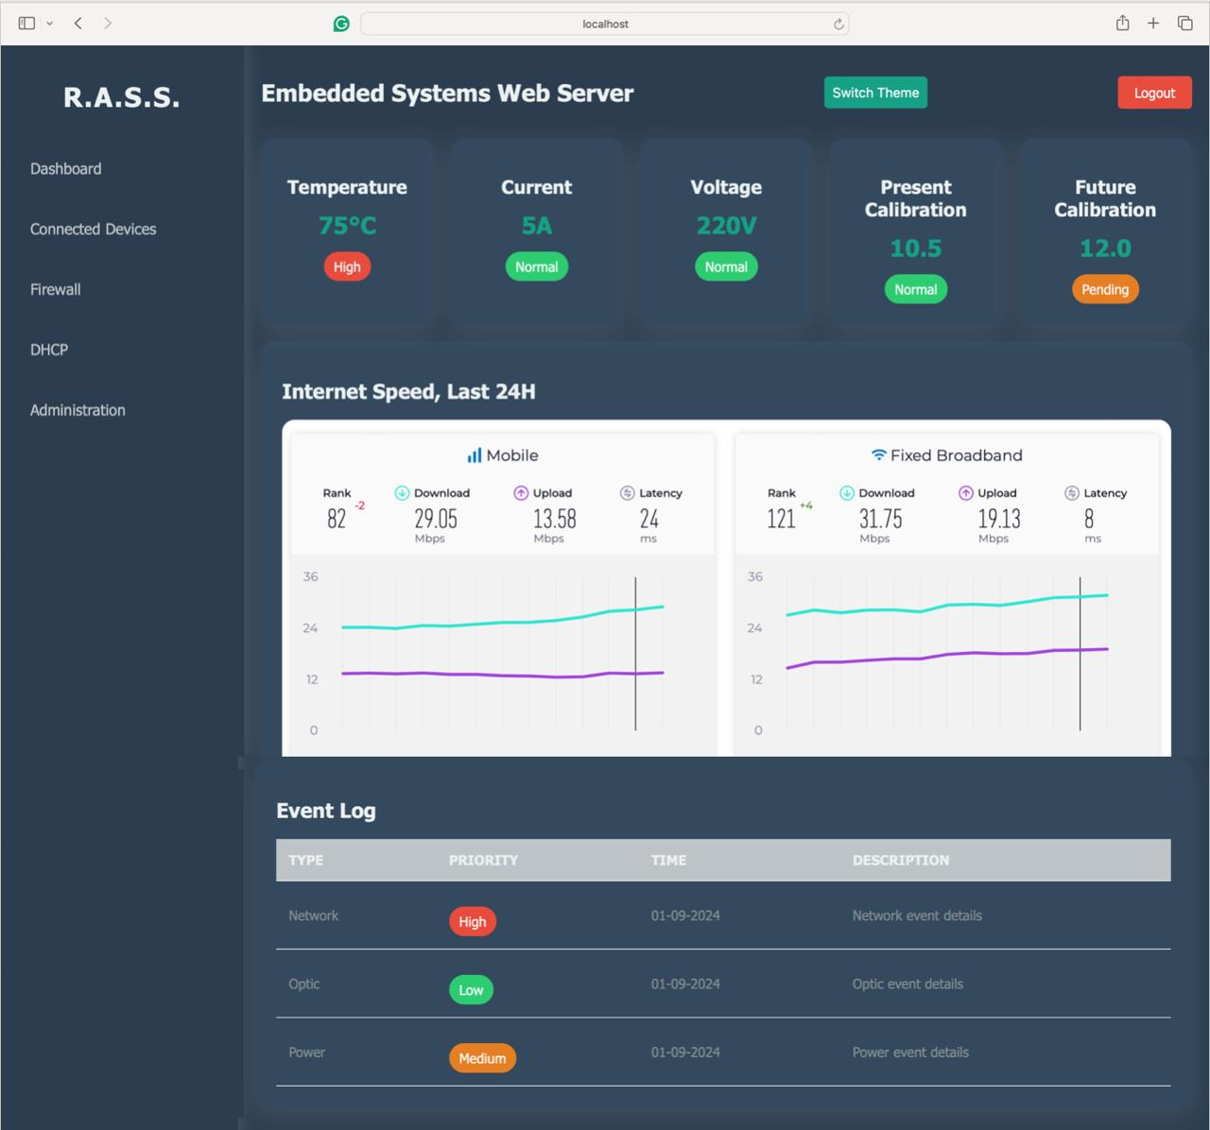
Project Progress

Slide 10
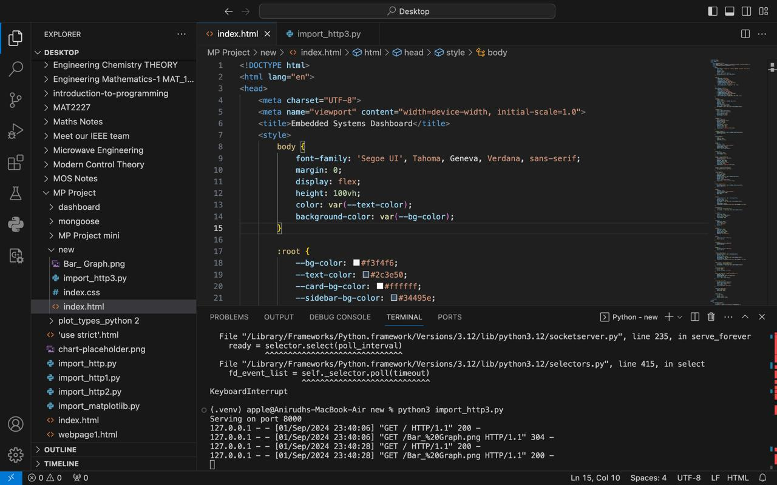
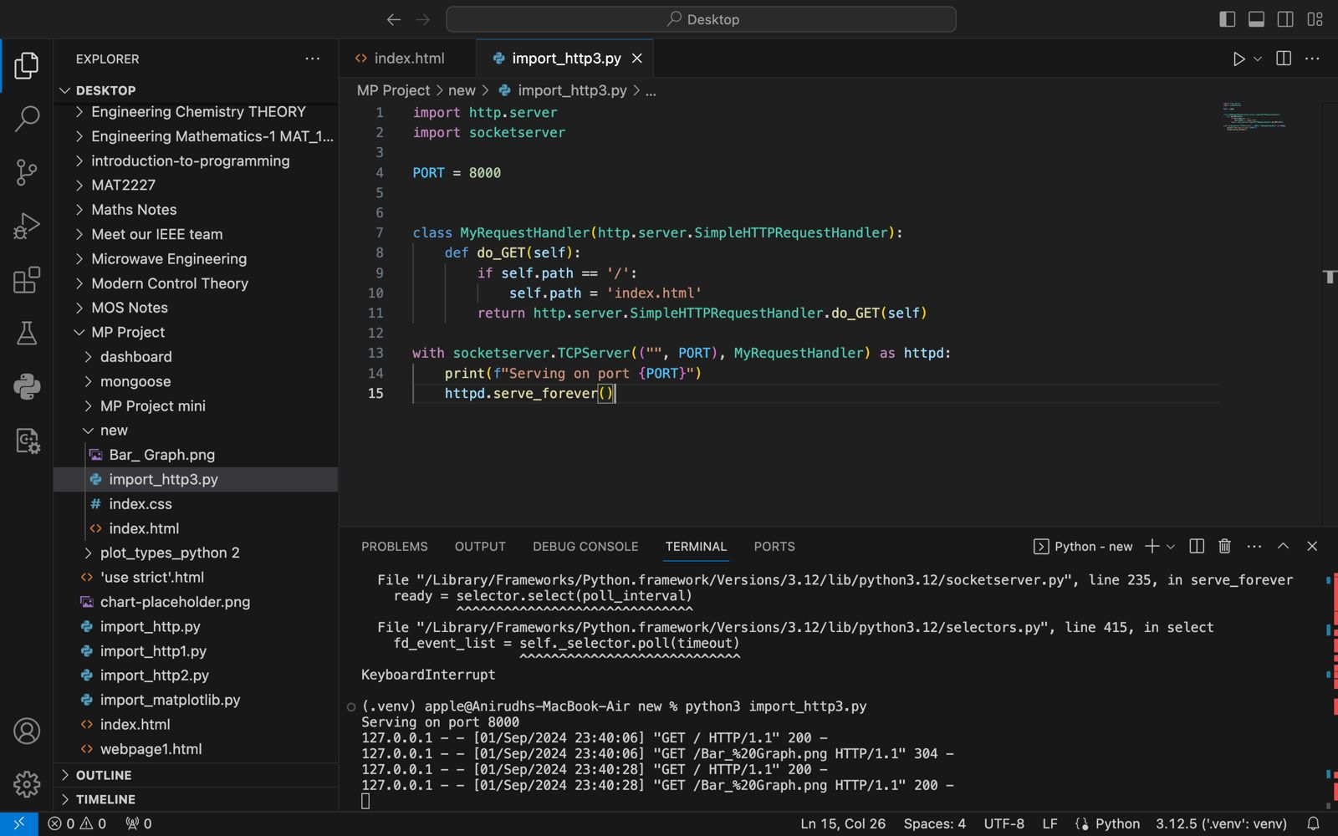
Frontend code snippets

Slide 11


EXPECTED RESULTS
Hardware setup :-
Configuring Microcontroller LPC2148 and Ethernet module ENC28J60 using microcontroller's SPI interface.
2) Software Integration using -
a) IDEs - Keil Microvision and VScode.
b) Mongoose Framework Integration
3) Web Server Integration –
Combining all the above mentioned results into the Web Server

Slide 12
EXPECTED RESULTS
4 )Data Transmission:-
a) Real-Time Data Transfer
b) Protocols Used:- Implementation of TCP/IP protocols for reliable data communication between the embedded device and the server.
c) Error handling
5)Database Management:-
Data Storage
Data Integrity
Data Access
6) Maintenance Systems:-
Develop measures to constantly check error or deviation in sensor data from the required thresholds
Automated Alerts
System Logs

Slide 13
References
https://www.youtube.com/watch?v=Z1RJmh_OqeA
https://mongoose.ws/reference-projects/
https://embetronicx.com/tutorials/microcontrollers/lpc2148/ultrasonic-sensor-interfacing-with-lpc2148/
https://www.electronicshub.org/embedded-systems-projects-ideas/
https://ijates.com/images/short_pdf/1396953085_P31-36.pdf
https://www.irdindia.in/journal_ijraet/pdf/vol1_iss1/3.pdf

